Slide 1
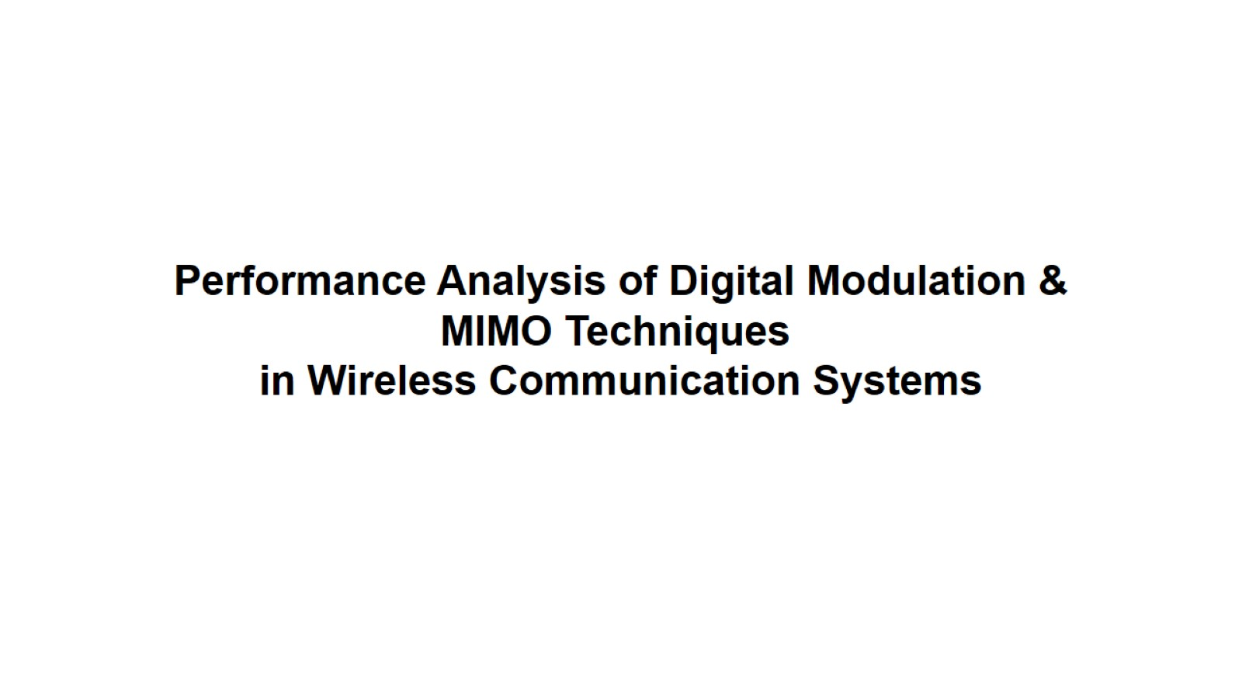
Performance Analysis of Digital Modulation & MIMO Techniques in Wireless Communication Systems

Slide 2
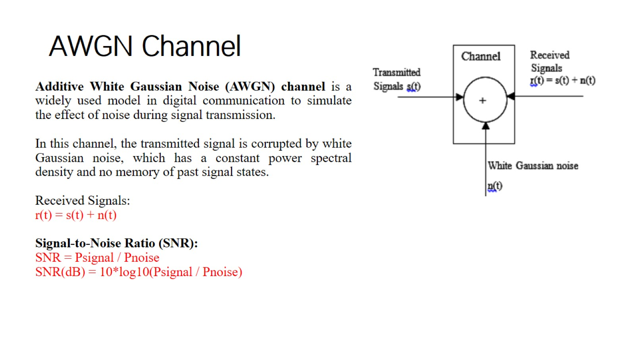
AWGN Channel

Slide 3
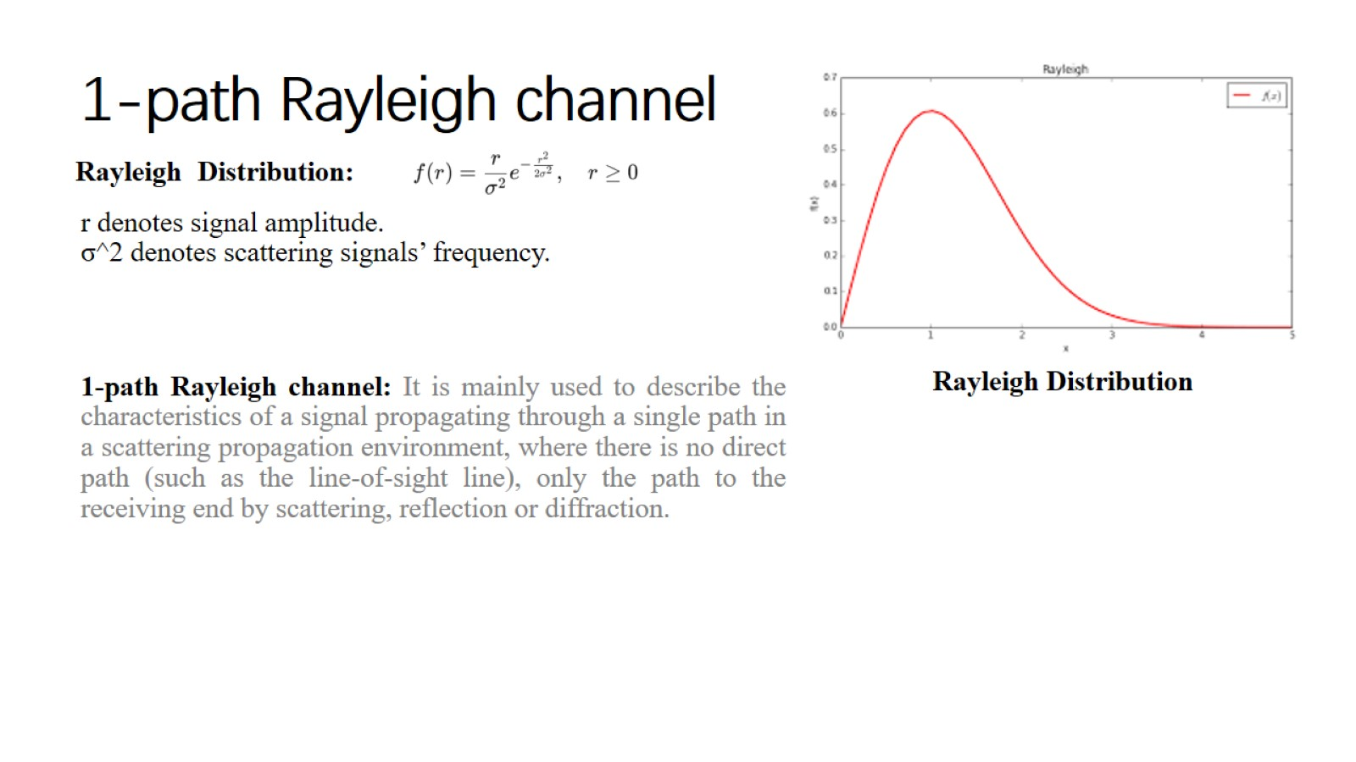
1-path Rayleigh channel

Slide 4
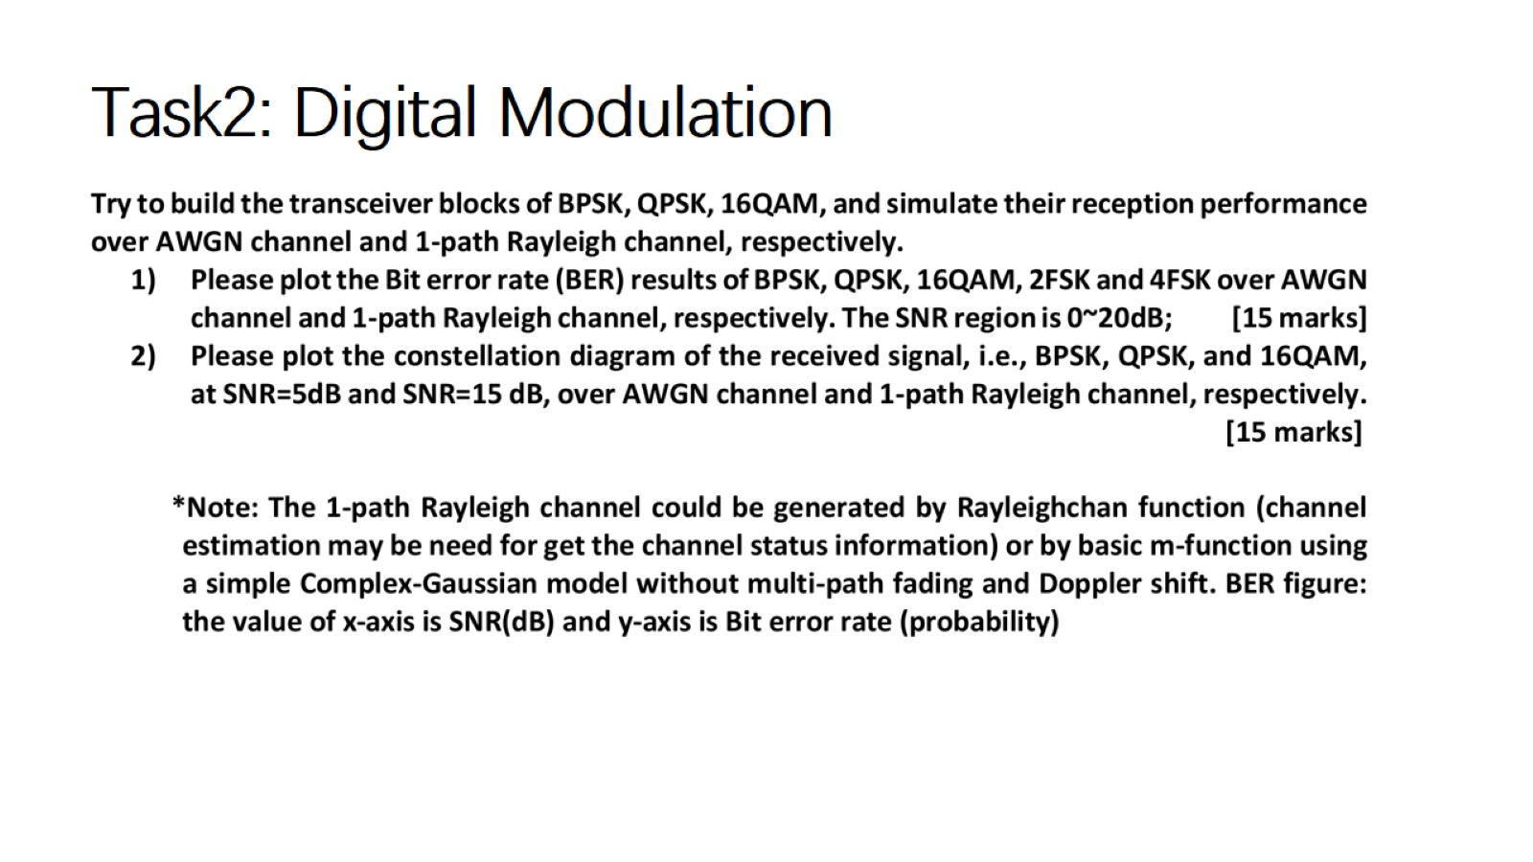
Task2: Digital Modulation

Slide 5
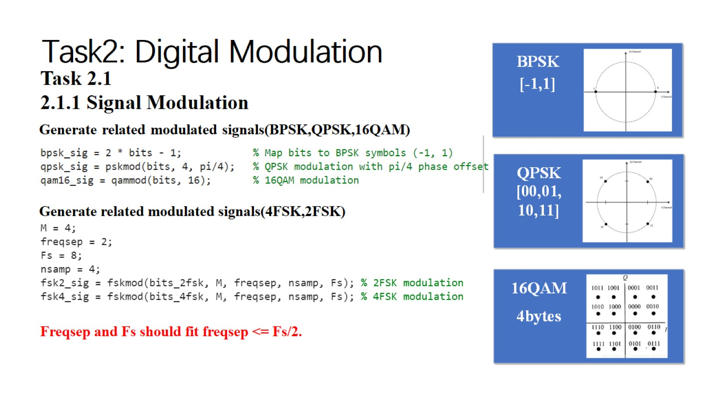
Task2: Digital Modulation

Slide 6
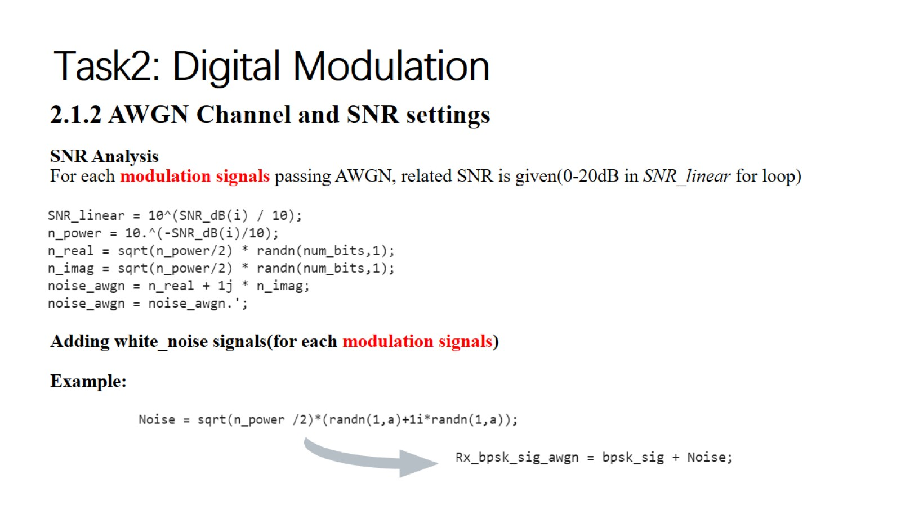
Task2: Digital Modulation

Slide 7
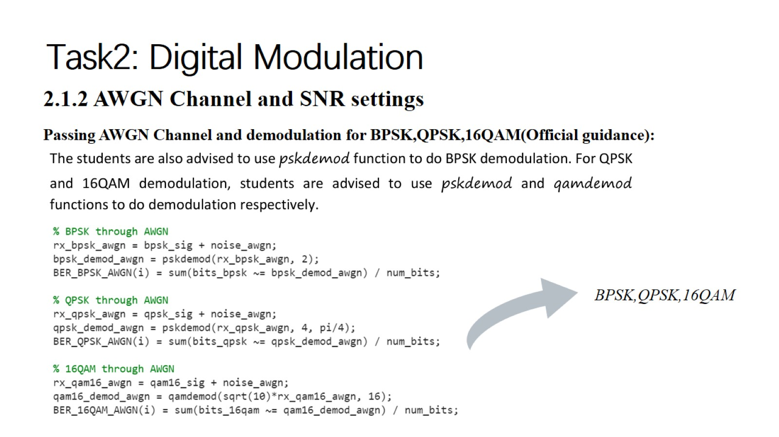
Task2: Digital Modulation

Slide 8
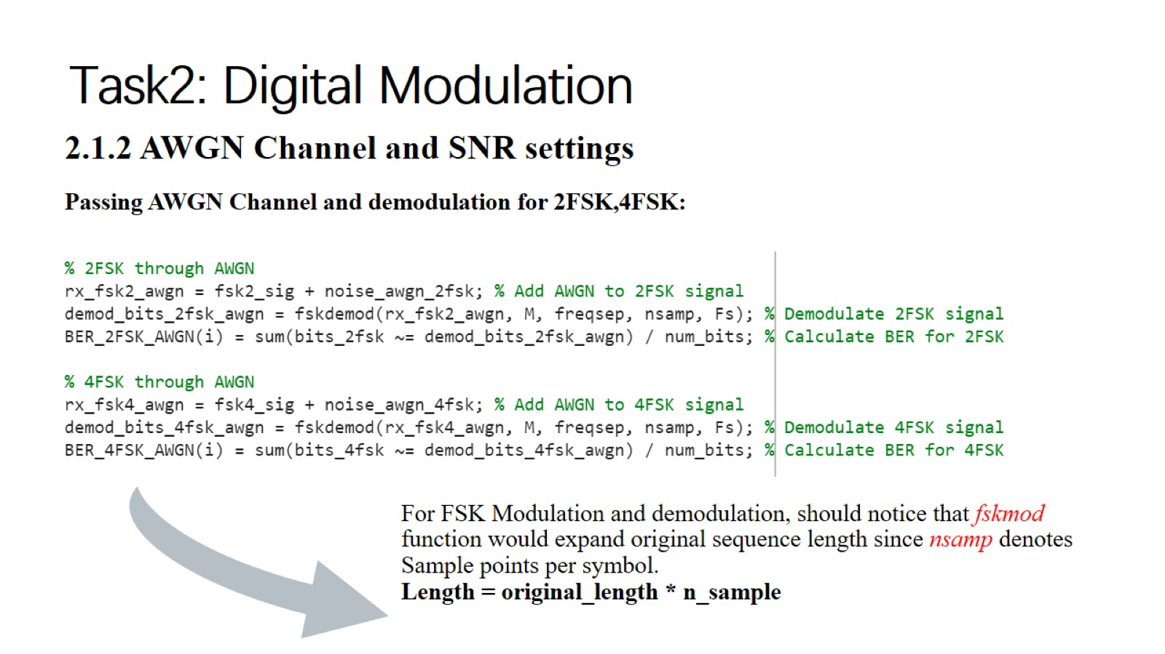
Task2: Digital Modulation

Slide 9
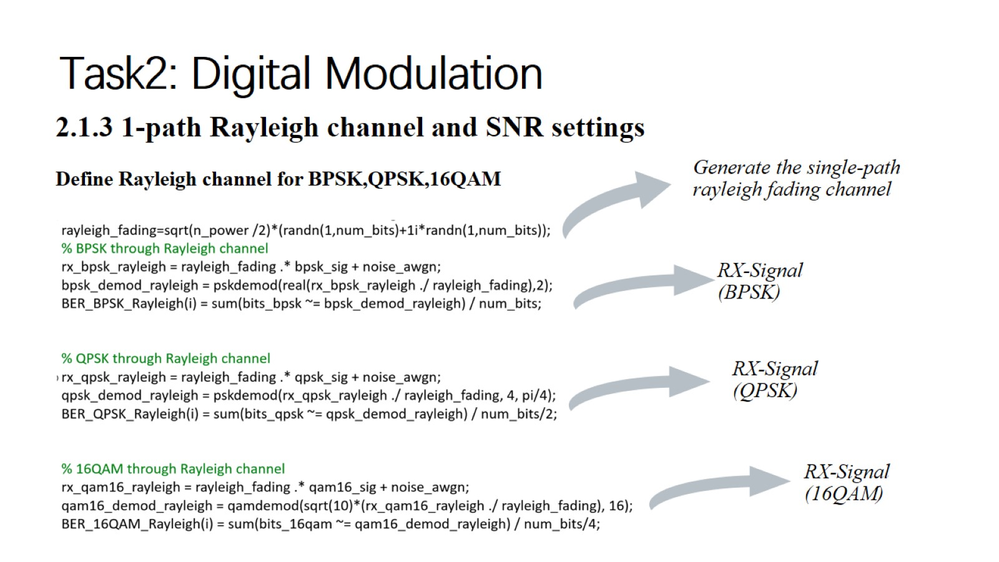
Task2: Digital Modulation

Slide 10
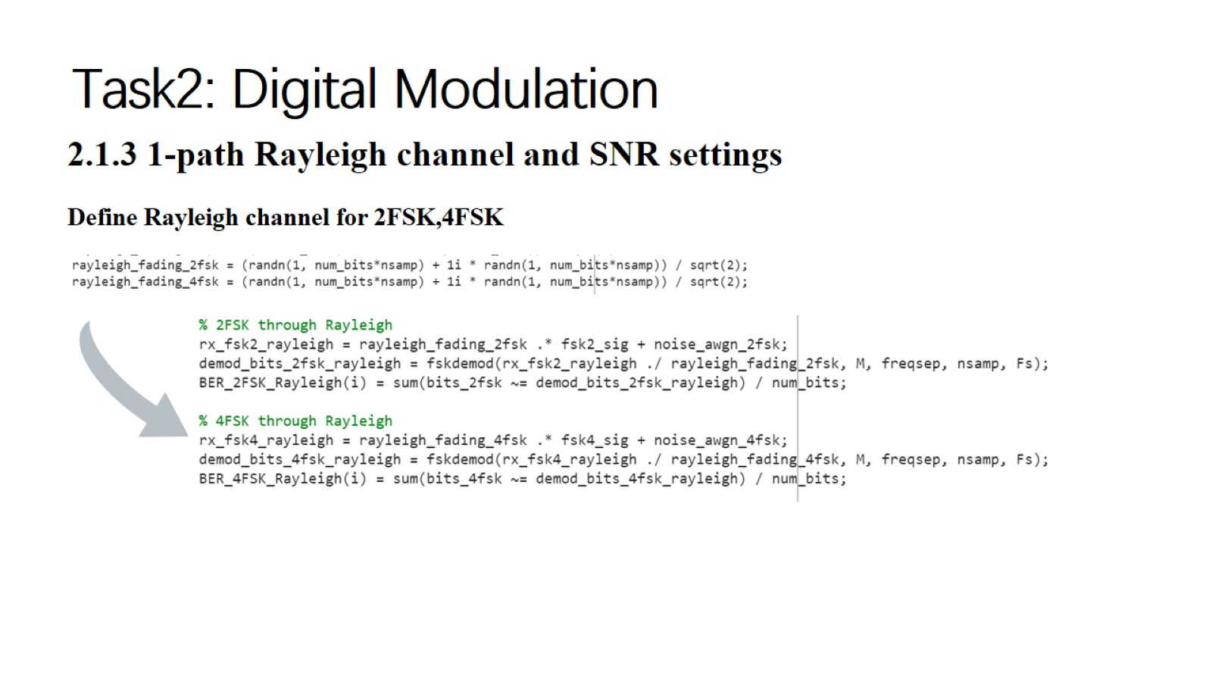
Task2: Digital Modulation

Slide 11
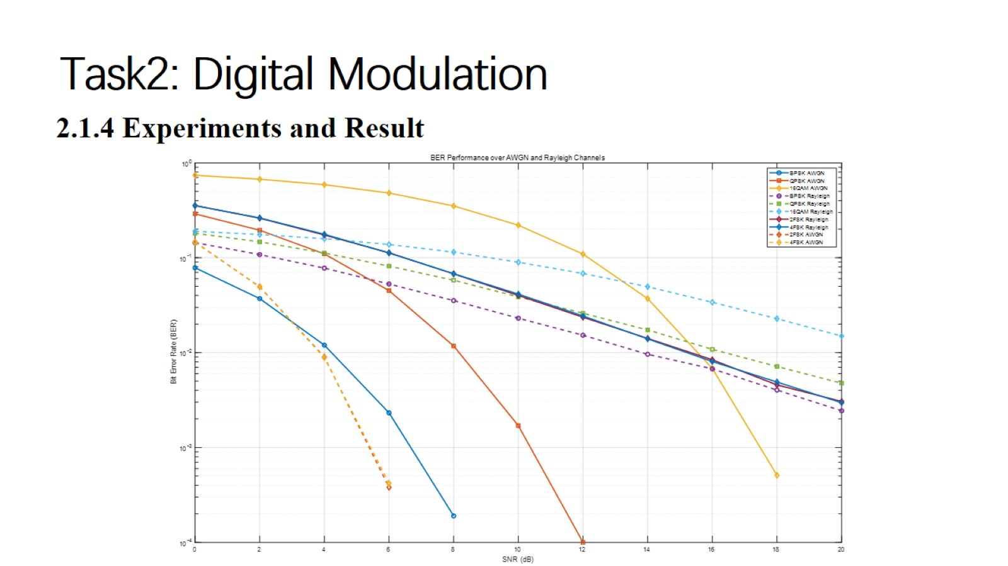
Task2: Digital Modulation

Slide 12
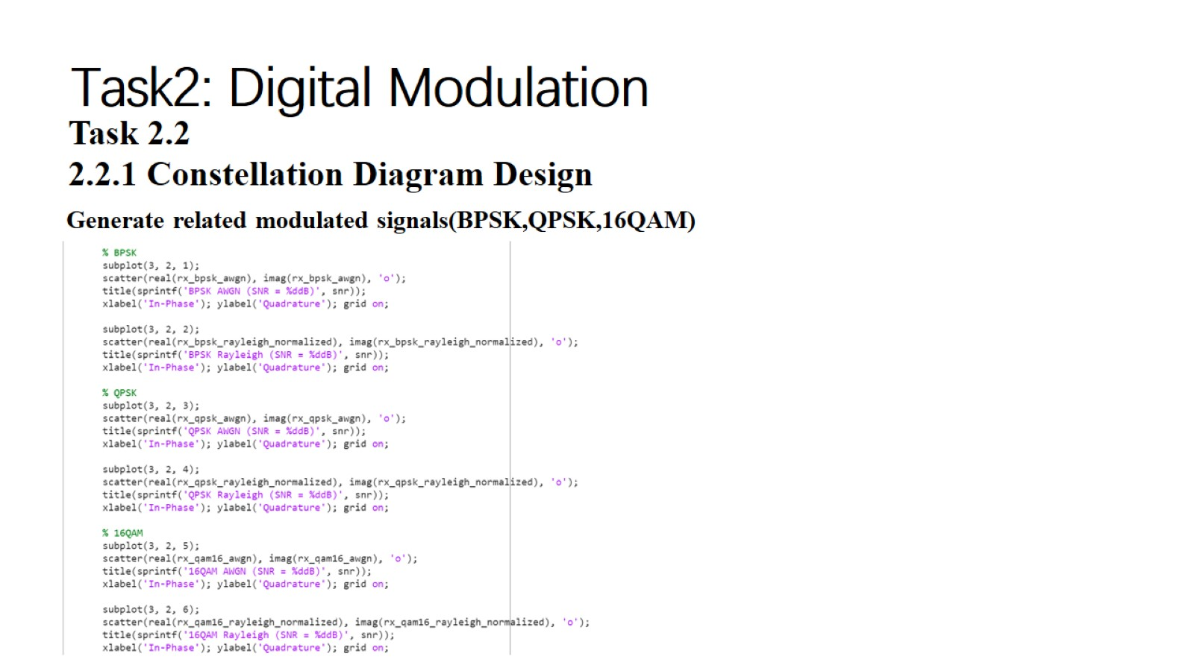
Task2: Digital Modulation

Slide 13
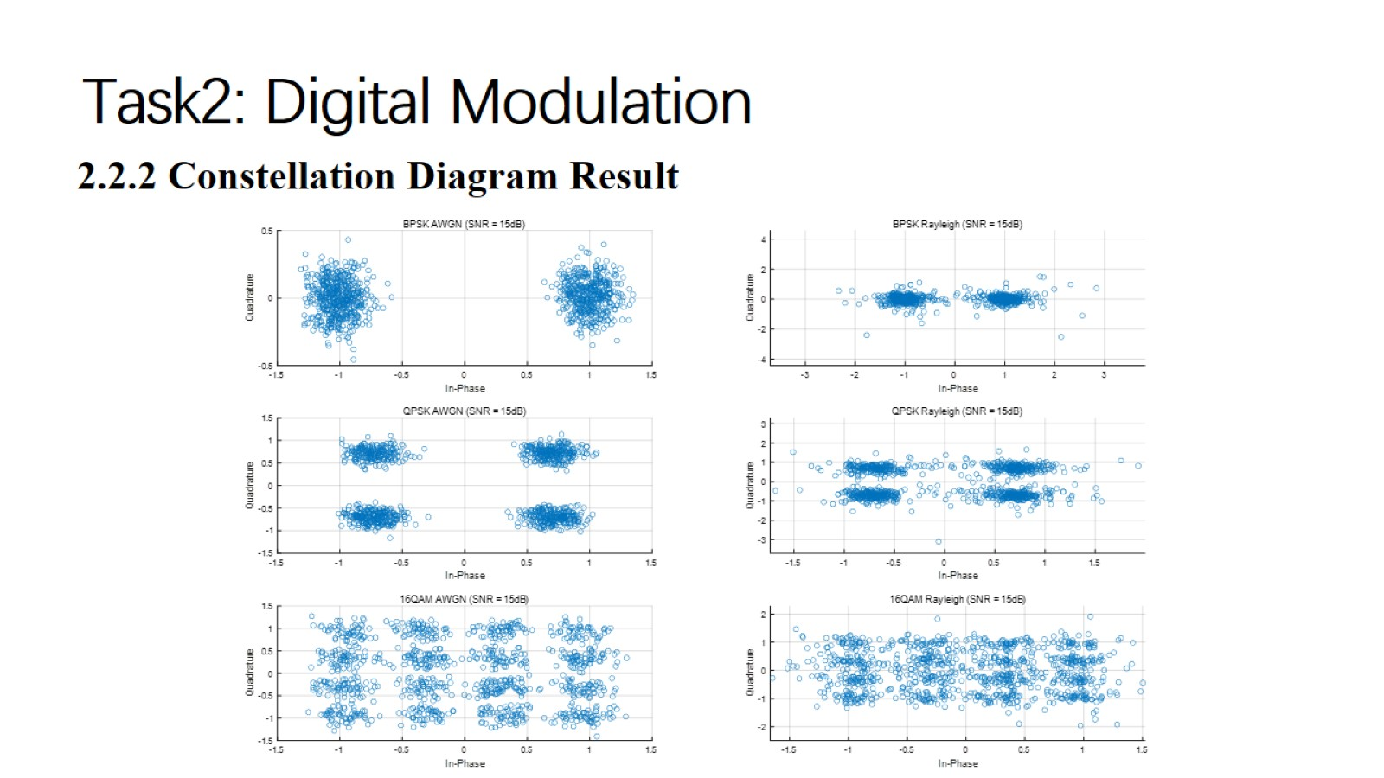
Task2: Digital Modulation

Slide 14
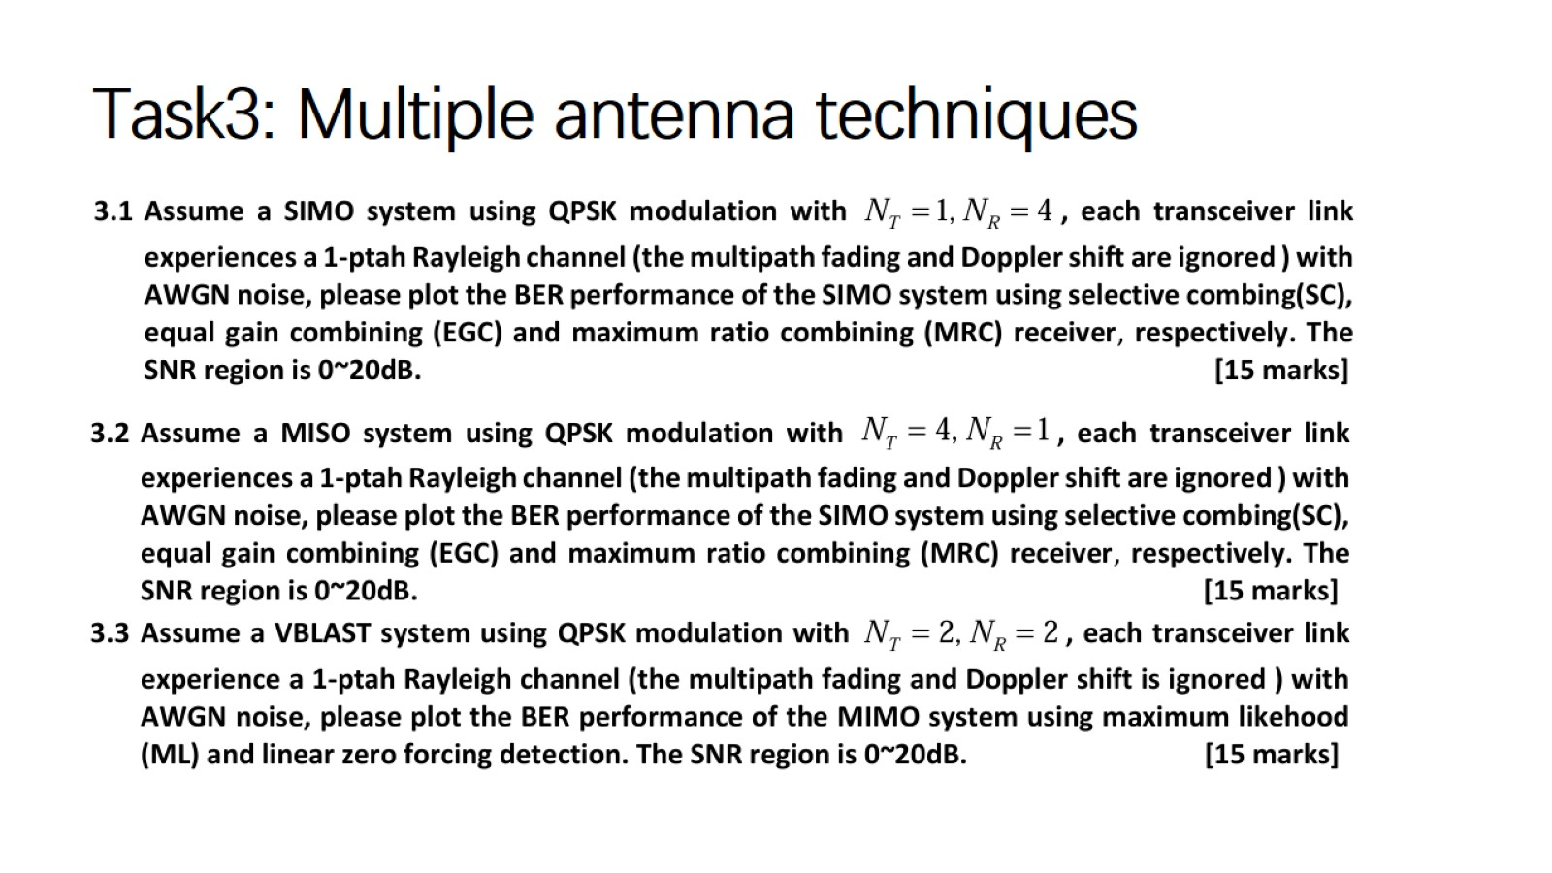
Task3: Multiple antenna techniques

Slide 15
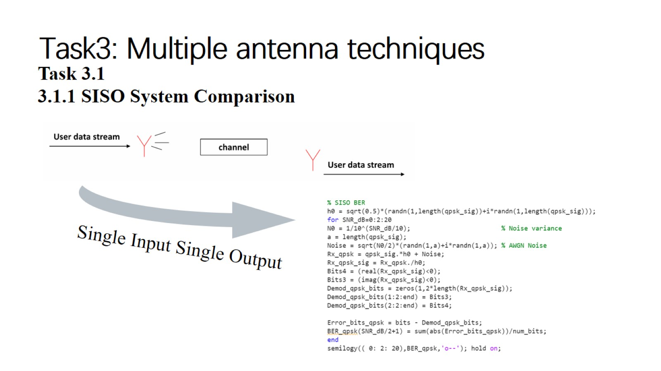
Task3: Multiple antenna techniques

Slide 16
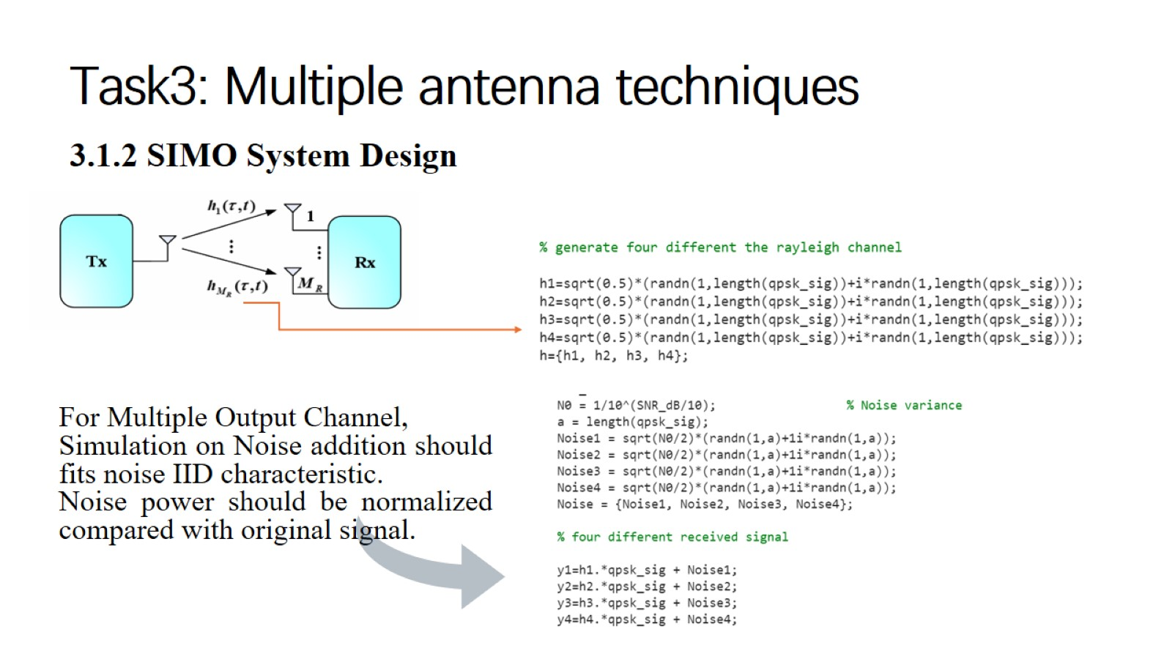
Task3: Multiple antenna techniques

Slide 17
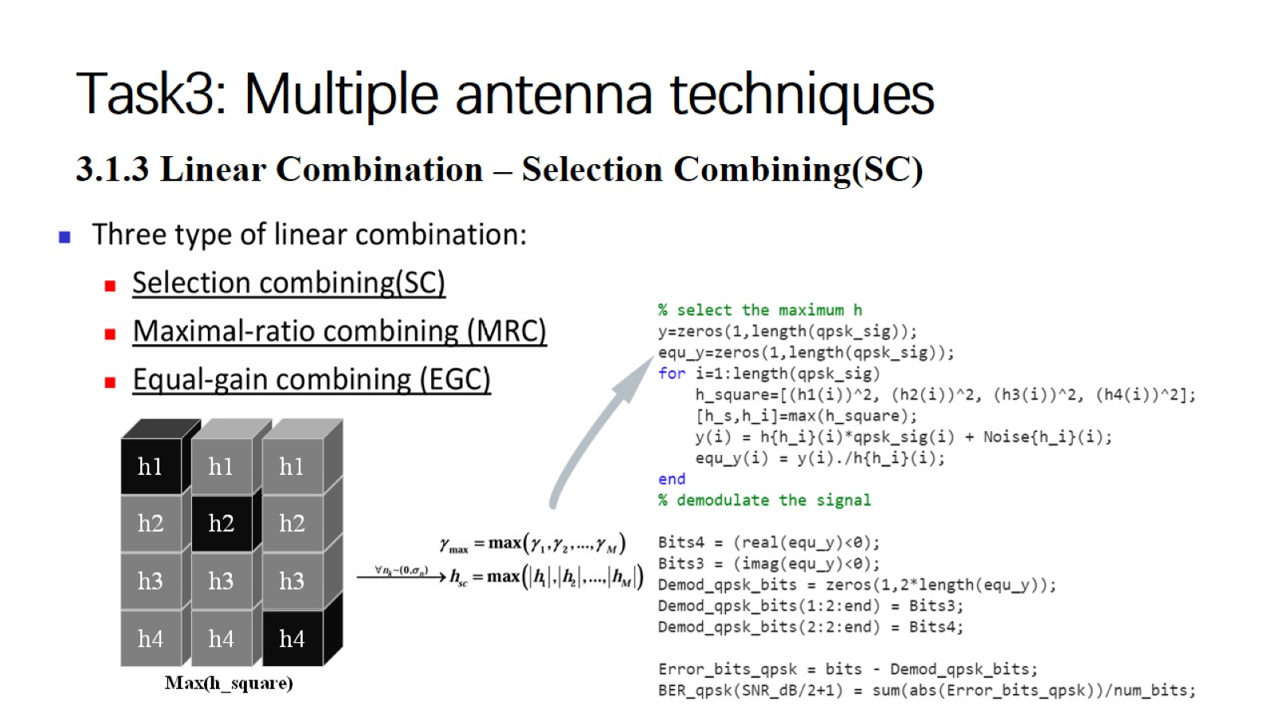
Task3: Multiple antenna techniques

Slide 18
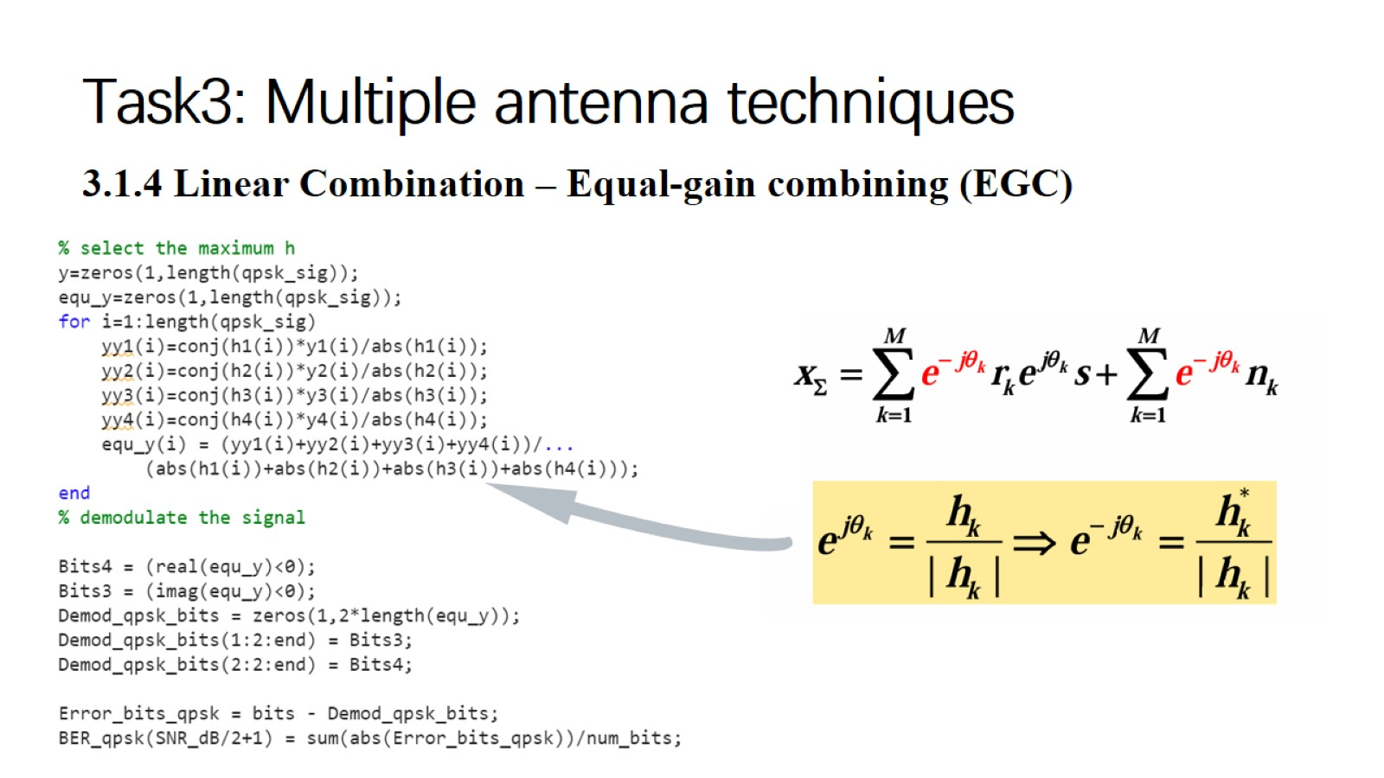
Task3: Multiple antenna techniques

Slide 19
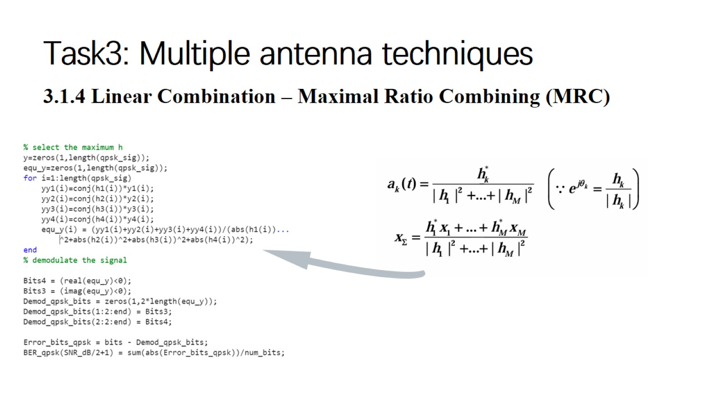
Task3: Multiple antenna techniques

Slide 20
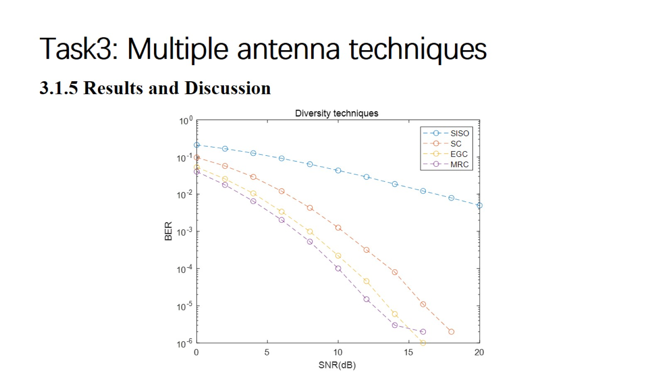
Task3: Multiple antenna techniques

Slide 21
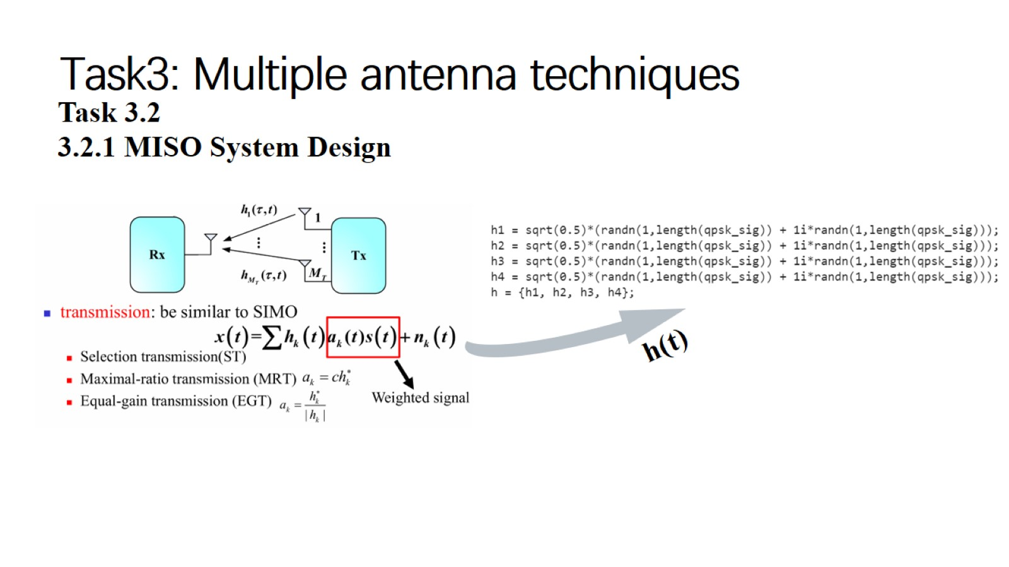
Task3: Multiple antenna techniques

Slide 22
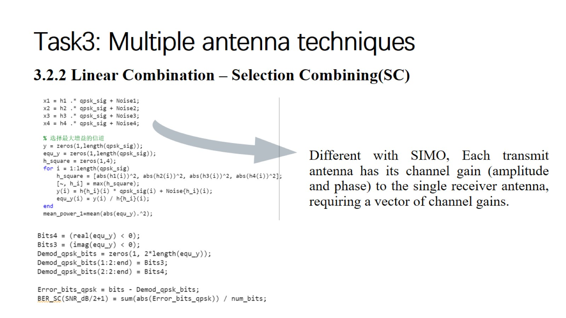
Task3: Multiple antenna techniques

Slide 23
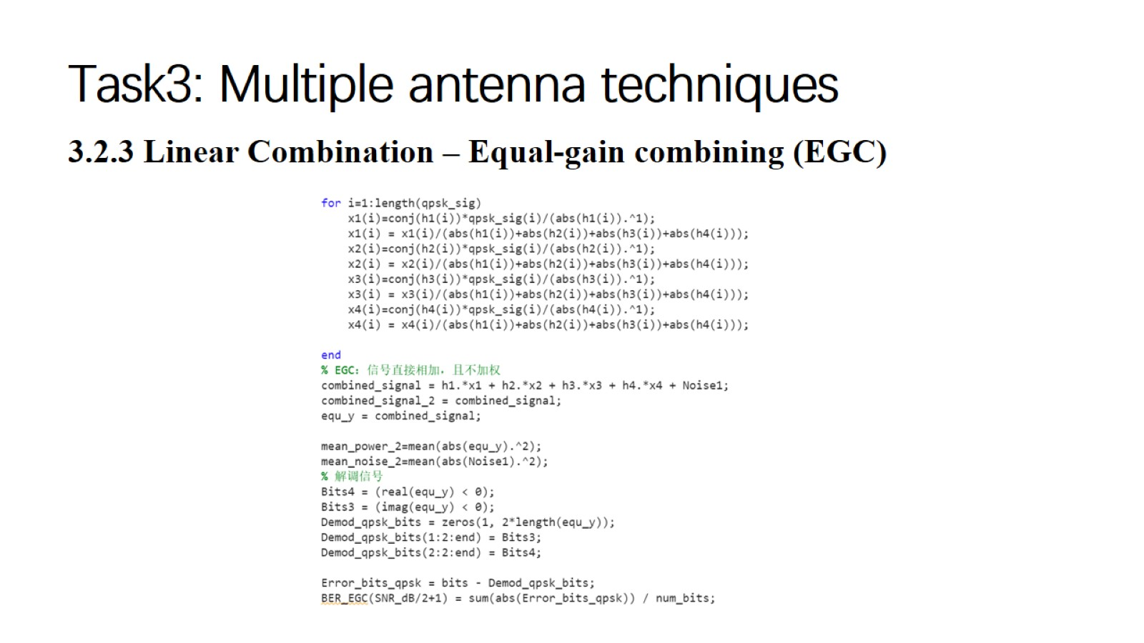
Task3: Multiple antenna techniques

Slide 24
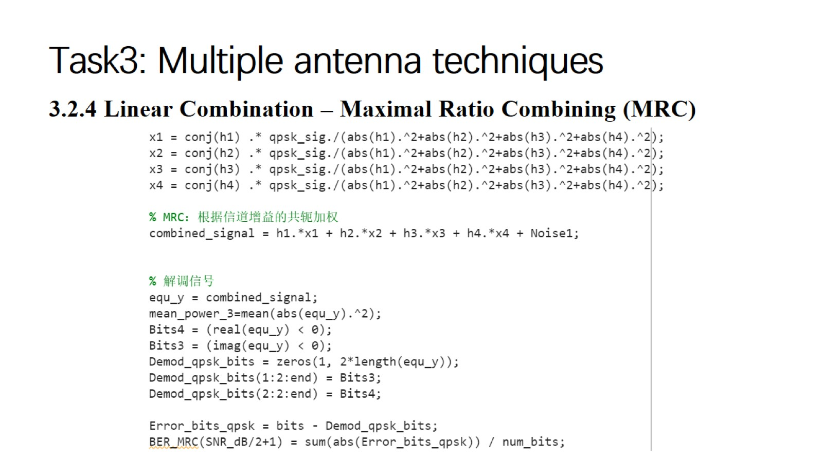
Task3: Multiple antenna techniques

Slide 25
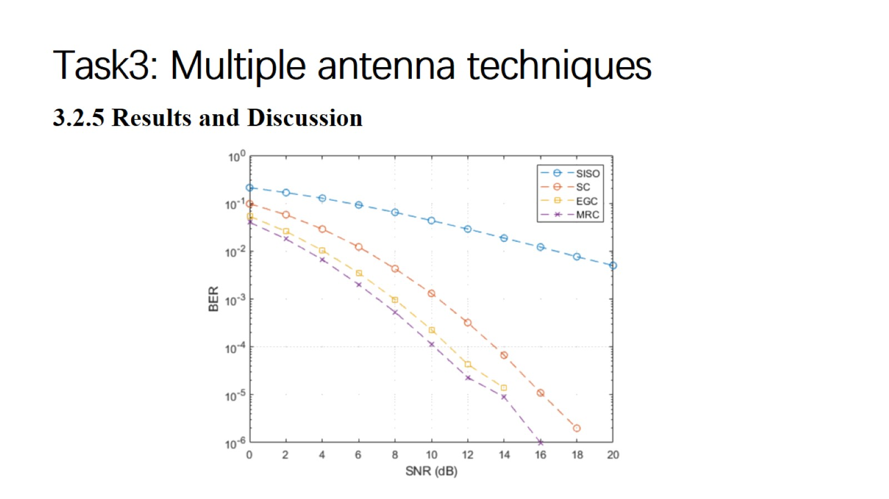
Task3: Multiple antenna techniques

Slide 26
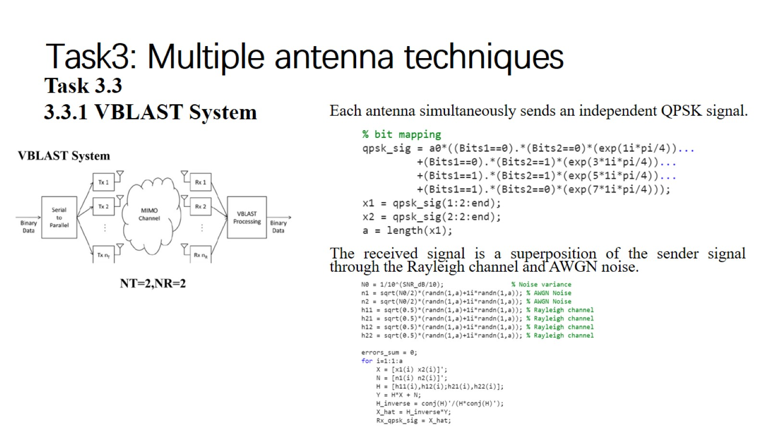
Task3: Multiple antenna techniques

Slide 27
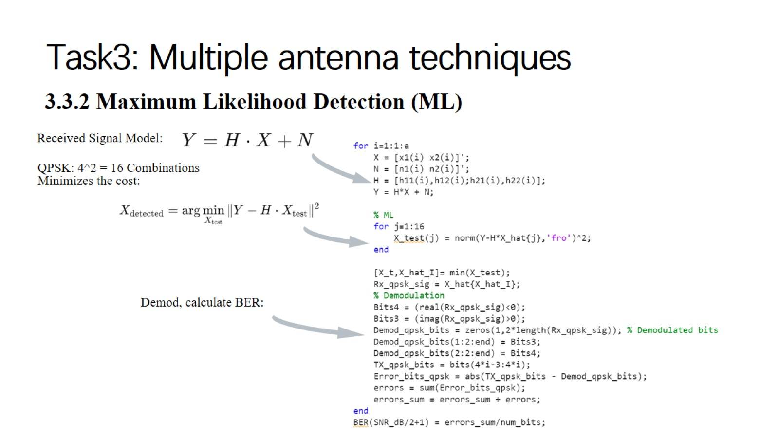
Task3: Multiple antenna techniques

Slide 28
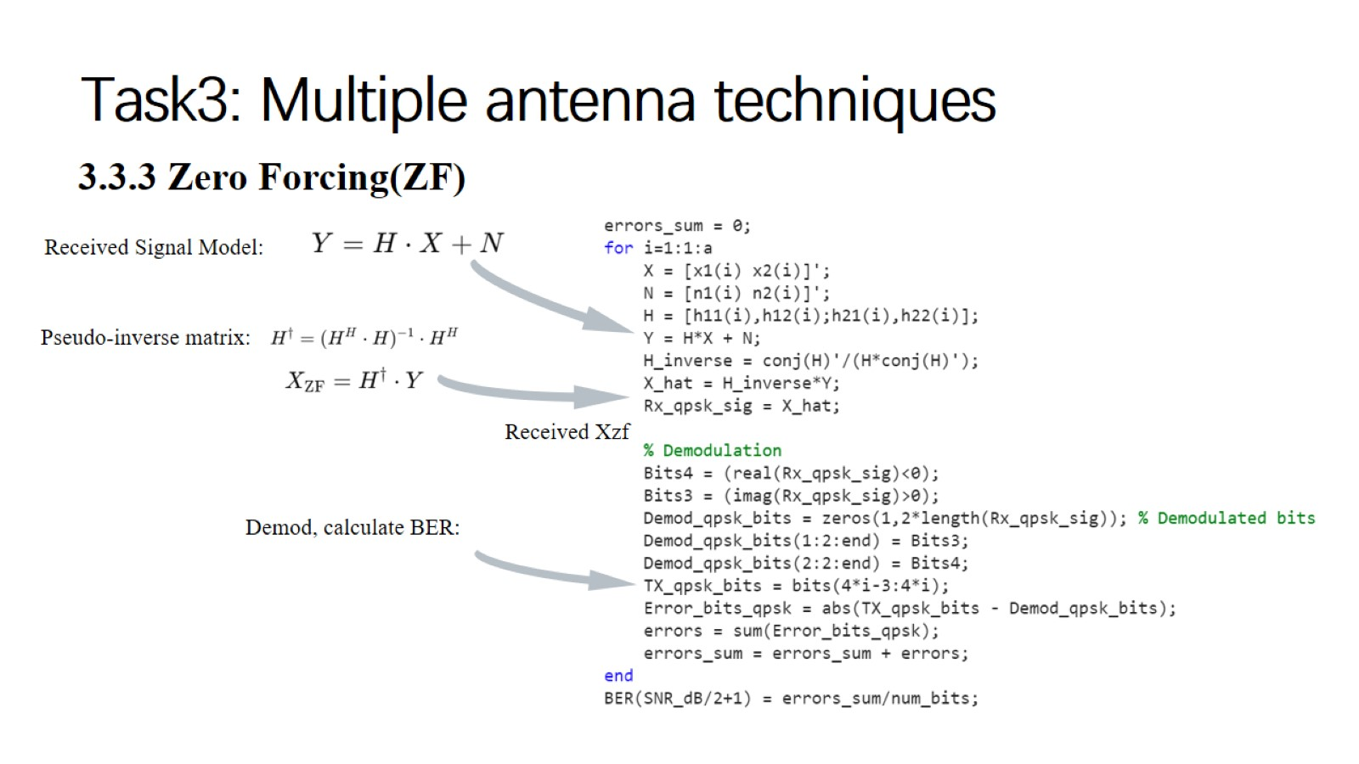
Task3: Multiple antenna techniques

Slide 29
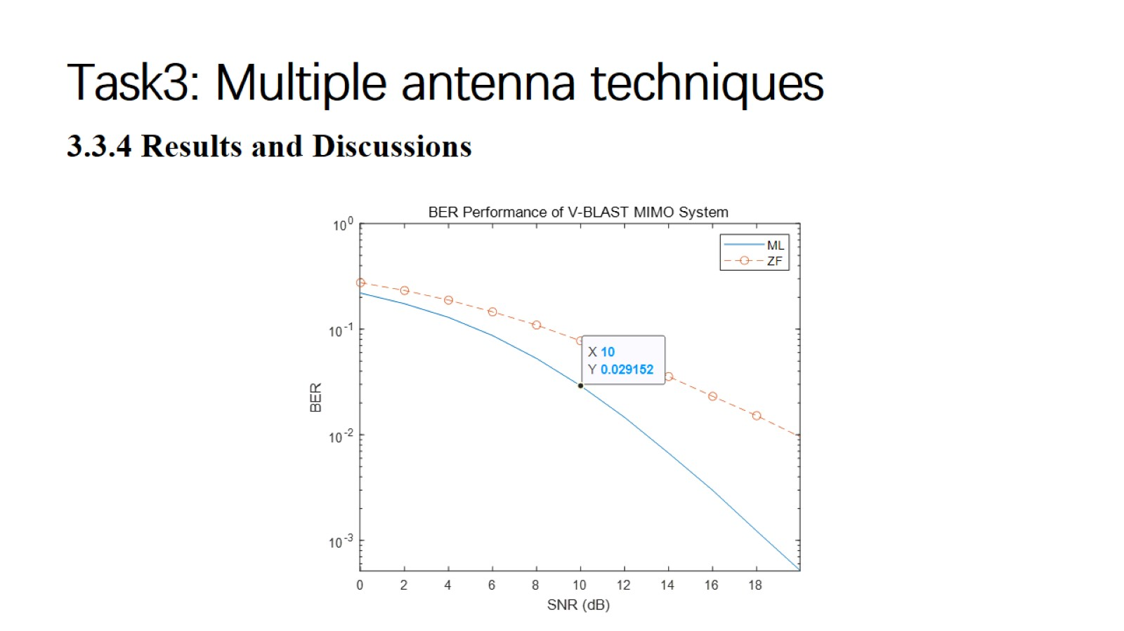
Task3: Multiple antenna techniques

Slide 30

Thank You!

